Slide 1
Web Server Programming
Introduction to Web Server Programming
Lecturer: Shakhnoza Muksimova
Email: Shakhnoza02@gachon.ac.kr

Slide 2

Content
WWW history and concepts
Client-Server architecture
Internet addressing mechanism, name servers, URLs
Basics of HTTP request/response cycle

Slide 3

WWW history and concepts
The World Wide Web (WWW), often called the Web, is a system of interconnected webpages and information that you can access using the Internet. It was created to help people share and find information easily, using links that connect different pages together. The Web allows us to browse websites, watch videos, shop online, and connect with others around the world through our computers and phones.

Slide 4
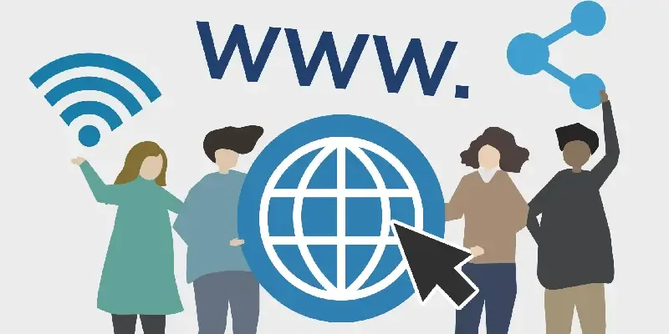
All public websites or web pages that people may access on their local computers and other devices through the internet are collectively known as the World Wide Web or W3. Users can get further information by navigating to links interconnecting these pages and documents. This data may be presented in text, picture, audio, or video formats on the internet.

Slide 5
History WWW
It is a project created, by Tim Berner Lee in 1989, for researchers to work together effectively at CERN. It is an organization, named the World Wide Web Consortium (W3C), which was developed for further development of the web. This organization is directed by Tim Berner's Lee, aka the father of the web. CERN, where Tim Berners worked, is a community of more than 1700 researchers from more than 100 countries. These researchers spend a little time on CERN and the rest of the time they work at their colleges and national research facilities in their home country, so there was a requirement for solid communication so that they can exchange data.

Slide 6
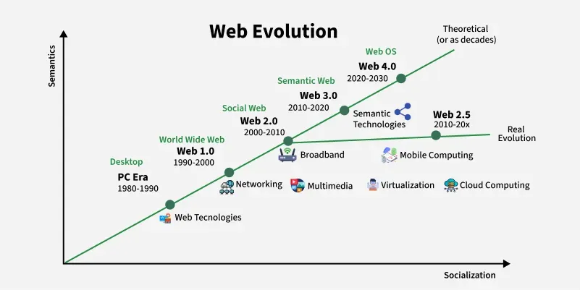
How Web Evolves?

Slide 7
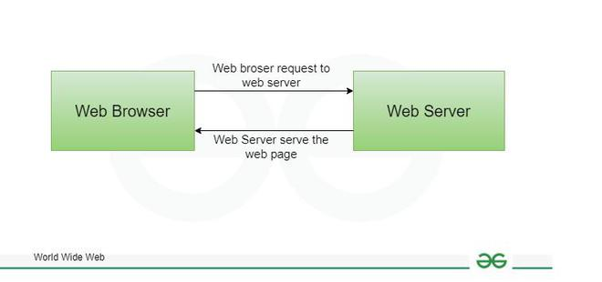
Working of World Wide Web(WWW)
A Web browser is used to access web pages. Web browsers can be defined as programs which display text, data, pictures, animation and video on the Internet. Hyperlinked resources on the World Wide Web can be accessed using software interfaces provided by Web browsers. Initially, Web browsers were used only for surfing the Web but now they have become more universal.
The diagram indicates how the Web operates just like client-server architecture of the internet. When users request web pages or other information, then the web browser of your system request to the server for the information and then the web server provide requested services to web browser back and finally the requested service is utilized by the user who made the request.

Slide 8
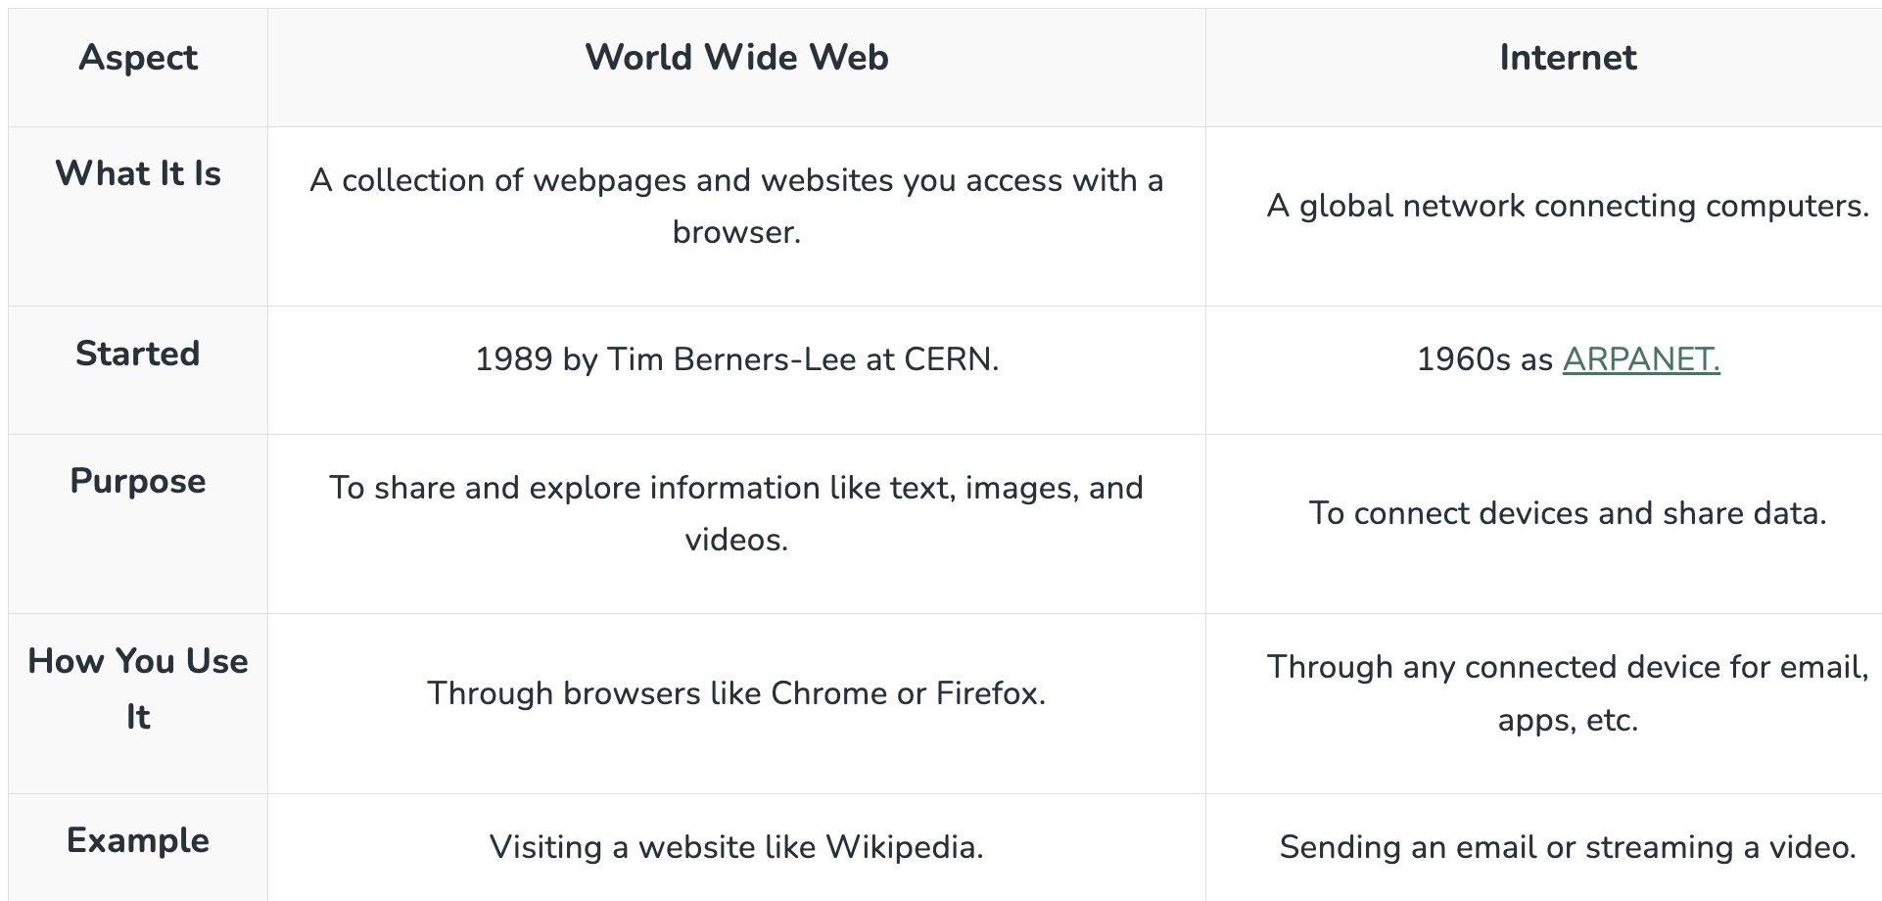
World Wide Web (WWW) Vs Internet

Slide 9
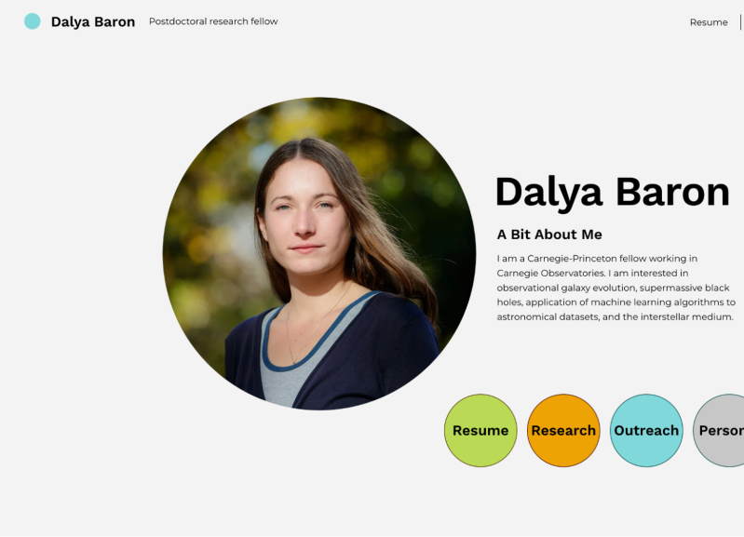
Static websites
One famous example of a static website is the Space Jam movie site from 1996, which only shows fixed text and images. A modern example is a personal portfolio site, where you can see information about a person’s skills and projects. In both cases, the content does not change unless the developer updates the HTML files.

Slide 10
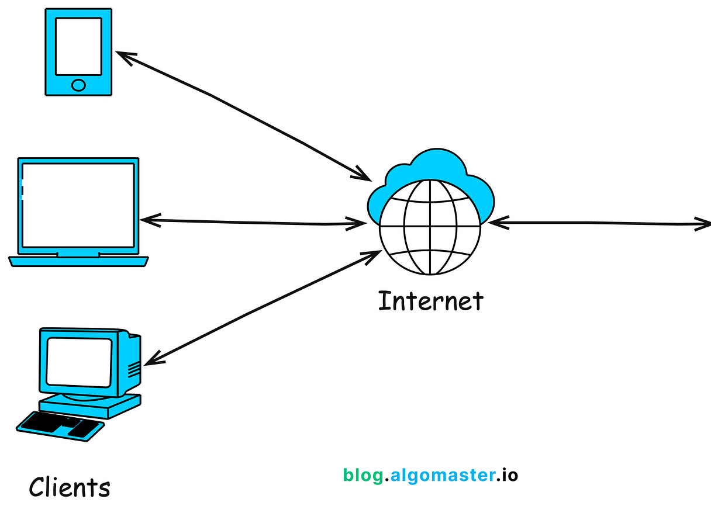
What is Client-Server Architecture?
Client-server architecture is a computing model in which multiple clients (users or devices) interact with a centralized server to access data, resources, or services.
In this model, the client initiates requests (like fetching data or performing an action), while the server handles those requests, manages resources, and responds accordingly, often serving multiple clients at the
same time.

Slide 11
Key Components:
Client: The client is typically a device or application that initiates a request to the server. This could be a web browser, a mobile app, or a desktop application.
Server: The server is a powerful computer or software application that processes requests from clients, manages resources, and delivers the requested services or data.
Network: The communication medium (usually the internet) that allows clients and servers to exchange data.

Slide 12
Visiting a Website
Let’s say you type algomaster.io in your browser:
Client → Browser sends a request to algomaster.io's web server over HTTP/HTTPS.
Server → Finds the HTML, CSS, and JS files and sends them back.
Client → Browser displays the page based on those files.

Slide 13
How Client-Server Architecture Works
The Client Initiates a Request: You (the client) perform an action like clicking a link, pressing “Send” on an email, or opening an app. That action triggers a request to a server.
The Request Travels Over the Network: This request usually in the form of an HTTP message is sent over the internet to a server’s IP address. Think of it like mailing a letter to a specific address.
The Server Receives and Processes the Request: The server listens on a specific port and handles incoming requests. It processes the data, runs logic, queries a database if needed, and prepares a response.
The Server Sends Back a Response: Once processing is done, the server sends the result back. This could be:
A webpage
Search results
A confirmation message
JSON data for a mobile app
The Client Displays the Response: The client receives the response and renders it on screen. What you see in your browser or app is the result of this back-and-forth.

Slide 14
Key Technologies Involved
Here are some of the technologies that enable this communication:
HTTP/HTTPS: The most common protocol used by browsers and web servers for communication.
DNS (Domain Name System): Translates human-friendly domain names (like algomaster.io) into server IP addresses.
TCP/IP: The underlying protocol that ensures data packets are delivered reliably between client and server.
Ports: Servers listen on specific ports (like 80 for HTTP or 443 for HTTPS) to accept requests.

Slide 15
Types of Client-Server Architectures
Client-server systems can vary significantly in complexity based on how many layers (or "tiers") are involved in processing and delivering data.
Let’s explore the most common models from the simplest one-tier setup to sophisticated, multi-tiered architectures used in large-scale applications.

Slide 16
1-Tier Architecture (Monolithic Model)
In 1-tier architecture, everything—the user interface, business logic, and data storage—resides in a single layer. All operations are handled on the same machine or within the same application.
Example Use Cases:
Microsoft Excel
Personal finance tools that store and compute everything locally
Pros:
Simple to build and deploy
No network communication overhead
Cons:
Not scalable
No separation of concerns
Unsuitable for multi-user environments
Best suited for small, standalone, offline applications.

Slide 17
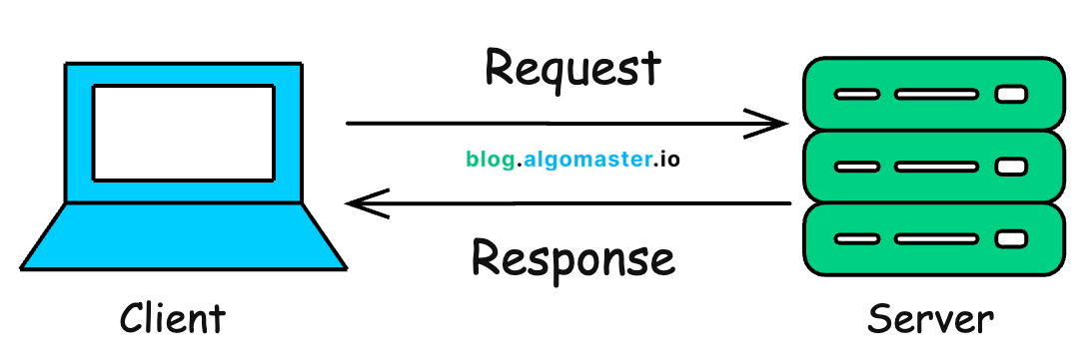
2-Tier Architecture
In a 2-tier architecture, the system is split into two parts:
The client, which handles the presentation layer (UI)
The server, which handles both the business logic and data storage
In a two-tier architecture, the client directly communicates with the server to send requests and receive responses. The server runs the logic and interacts with the database to return results.
Example Use Case:
A desktop application that connects directly to a central database to retrieve and display data.
Pros:
Simple and fast for a small number of users
Easy to implement
Cons:
Poor scalability as more clients are added
Performance bottlenecks on the server
Difficult to update logic across different clients
Suitable for internal tools or apps with a small user base and limited traffic

Slide 18
3-Tier Architecture
The 3-tier architecture introduces a dedicated Application Layer (also called the business logic layer) between the client and the data server.
This creates a clear separation of concerns and is the most commonly used architecture for modern web and enterprise applications.
Pros:
Better scalability and maintainability
Logic is centralized, so clients are lightweight
Improved security and abstraction
Cons:
More complex than 1- or 2-tier setups
Slightly increased latency if layers aren't optimized
Ideal for web apps, SaaS products, and large internal tools.

Slide 19
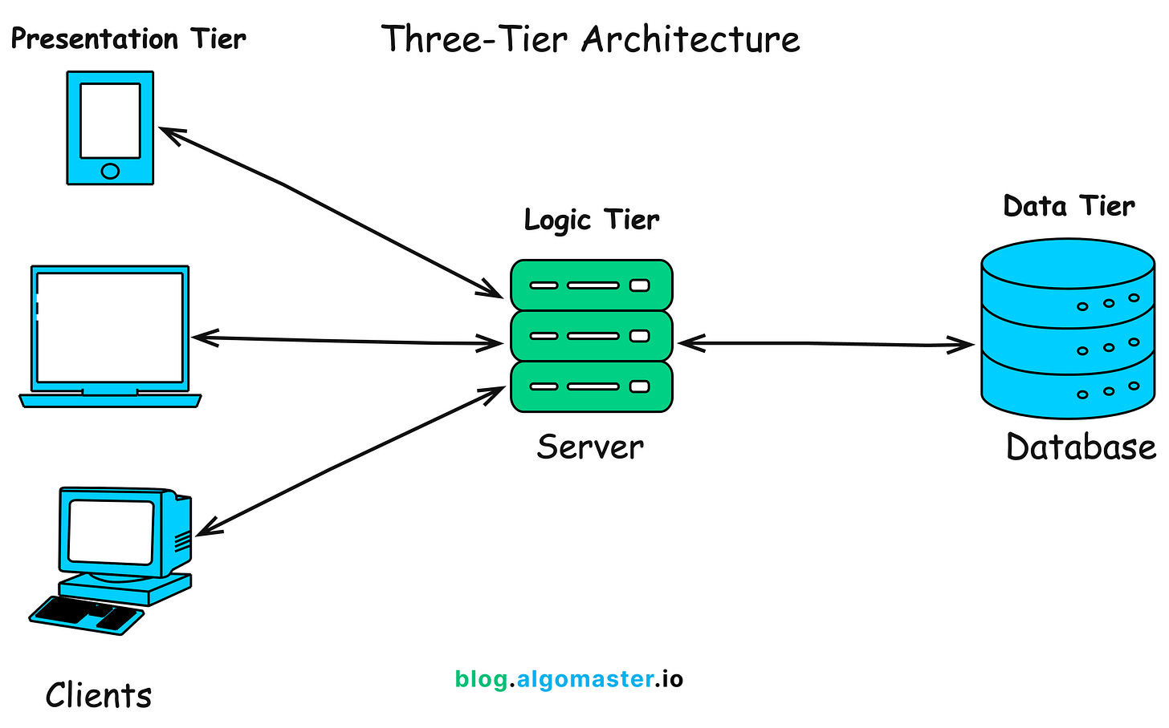
3-Tier Architecture
Client (Presentation Layer): The front-end interface users interact with (e.g., a browser or mobile app).
Application Server (Logic Layer): Processes client requests, applies business rules, and interacts with the database.
Database Server (Data Layer): Handles storage, retrieval, and management of data.

Slide 20
N-Tier Architecture
N-tier architecture builds on the 3-tier model by adding specialized layers for specific responsibilities such as caching, load balancing, authentication, analytics, or API gateways.
Each layer focuses on one concern and communicates only with adjacent layers, enabling high modularity and scalability
Pros:
Highly scalable and fault-tolerant
Individual layers can be developed, deployed, and scaled independently
Supports complex workflows and distributed teams
Cons:
More difficult to design, maintain, and debug
Higher latency if not optimized
Requires strong DevOps and monitoring practices
Best for enterprise-grade systems, cloud-native apps, and services that serve millions of users.

Slide 21
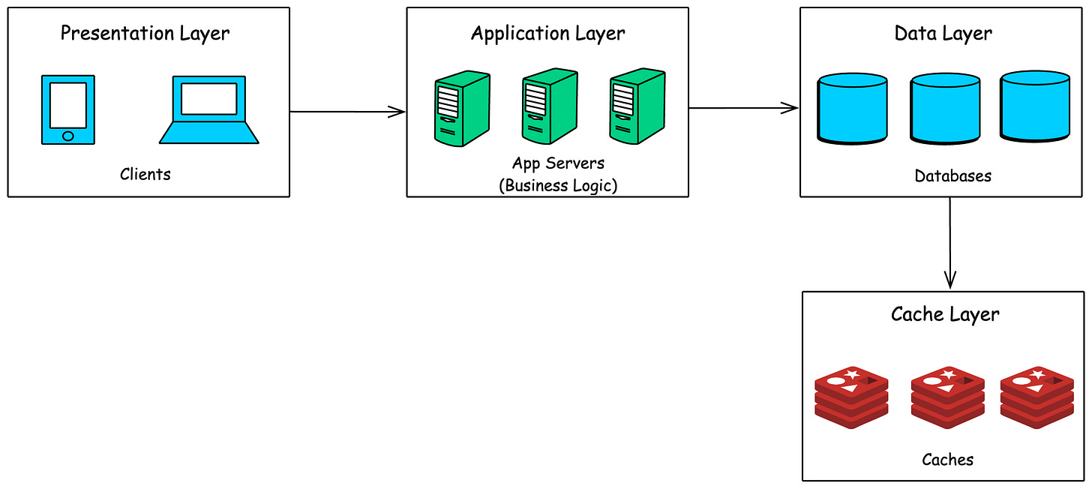
N-Tier Architecture
Common Layers:
Client: User interface or front-end application.
Presentation Layer: Manages the user interface and presentation logic.
Application Layer: Handles business logic and rules.
Data Layer: Manages data access and storage.
Additional Layers (optional): For caching, logging, security, etc.
A large e-commerce platform with separate services for user authentication, product catalog, shopping cart, and payment processing might use an N-tier architecture.

Slide 22
Advantages of Client-Server Architecture
The client-server model offers several advantages, which is why it’s so widely used:
Centralized Management: All critical data, resources, and services reside on the server, which means they can be monitored, updated, and secured from a central location.
Scalability: Client-server systems are built to grow. You can scale vertically by upgrading server hardware (e.g., adding more RAM or CPU) or scale horizontally by adding more servers behind load balancers to distribute traffic.
Efficient Resource Sharing: One server can serve multiple clients simultaneously, enabling shared access to databases, file storage, and applications.
Security: With everything centralized, it’s easier to implement and enforce authentication, authorization, encryption, and access control.

Slide 23
Real-World Applications
Client-server architecture is ubiquitous in modern computing. You interact with it dozens of times a day, often without even realizing it.
🌐 Web Browsing
When you visit a site like www.wikipedia.org, your browser (client) sends a request to a web server, which responds with the HTML, CSS, and content of the page.
📧 Email Services
Email apps like Gmail, Outlook, or Apple Mail act as clients that connect to mail servers (using protocols like SMTP, IMAP, or POP3) to send, receive, and sync your emails.
🏦 Online Banking
Banking apps and websites rely on client-server models to:
Authenticate users
Process transactions
Display real-time account data all while keeping data encrypted and secure on the server.
☁️ Cloud Computing
Cloud providers like AWS, Google Cloud, and Microsoft Azure offer on-demand services (compute, storage, databases) using a client-server model. Your apps (clients) communicate with cloud APIs (servers) to scale seamlessly.

Slide 24
What is an IP Address?
An IP address, or Internet Protocol address, is a unique string of numbers assigned to each device connected to a computer network that uses the Internet Protocol for communication. It serves as an identifier that allows devices to send and receive data over the network, ensuring that this data reaches the correct destination..

Slide 25
Structure and Types of IP Address
IP addresses are an important part of the Internet. It can be represented as Internet Protocol address. A unique address that identifies the device over the network. They are made up of a series of numbers or alphanumeric characters that help us to identify devices on a network. Almost every device we use is connected to the Internet, whether a smartphone, computer, or smart home device. For these devices to communicate with each other, they need a unique identifier, known as an IP address.

Slide 26
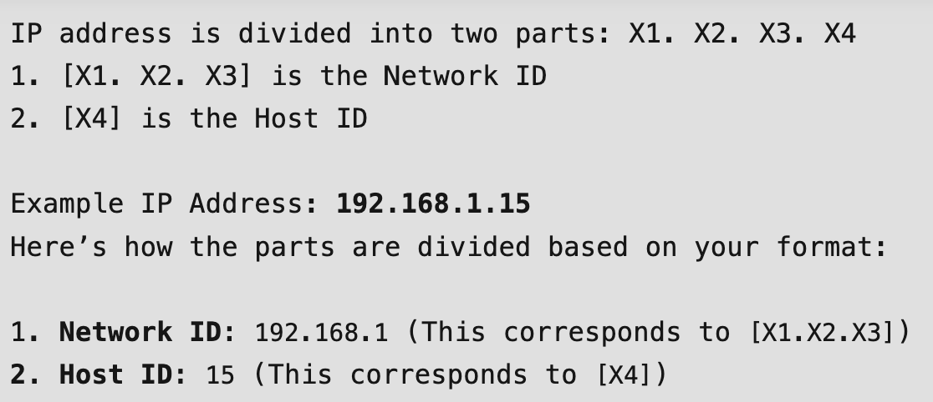
Structure of IP Address
Network ID: The left-hand IP address part identifies the specific network where the device is located. In a normal home network, where the device has an IP address of 192.168.1.32, the 192.168.1 part of the address will be the network ID. Filling in the last part that is not zero is customary, so the device's network ID is 192.168.1.0.
Hosting ID: The host ID is part of the IP address that was not taken by the network ID. Identifies a specific device (in the TCP / IP world, we call devices “host”) in that network. Continuing with our example of the IP address 192.168.1.32, the host ID will be 32- the unique host ID on the 192.168.1.0 network.

Slide 27
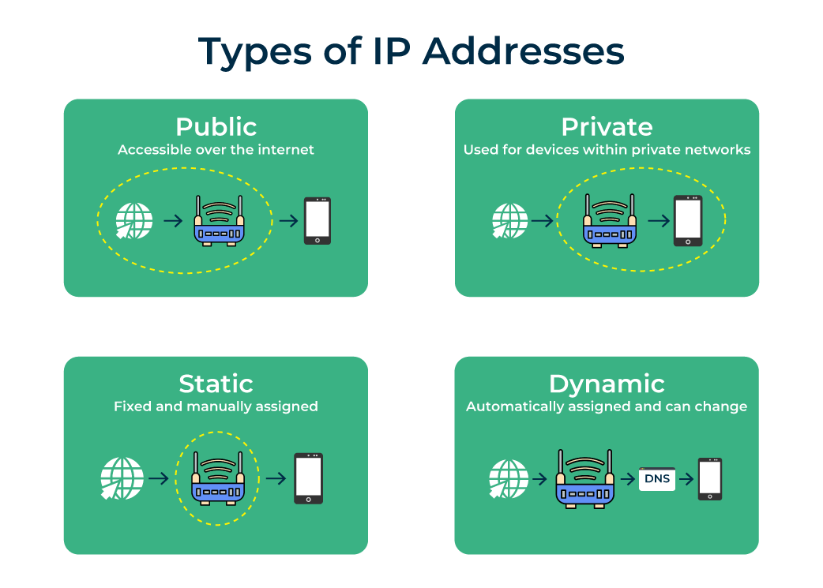
Types of IP Addresses
Private IP: An address used inside a local network (home, office) to identify devices within that network.
Public IP: An address provided by the Internet Service Provider (ISP) that allows devices to communicate over the internet.
Static IP: A fixed address that never changes, often used for servers or hosting websites.
Dynamic IP: An automatically assigned address that changes whenever a device reconnects to the network.

Slide 28
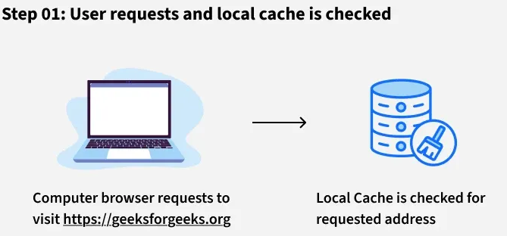
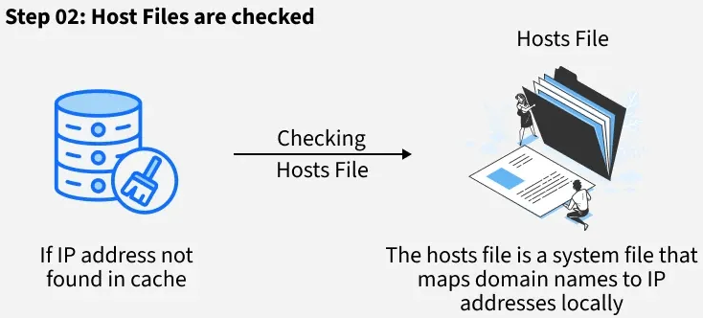
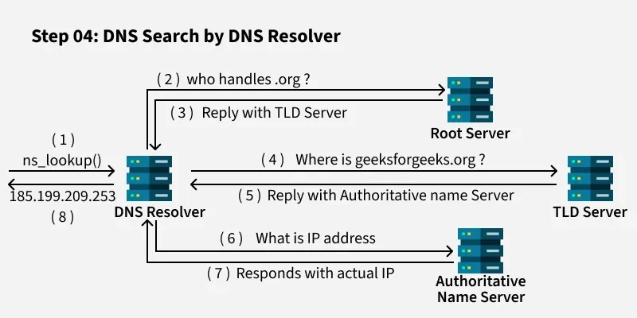
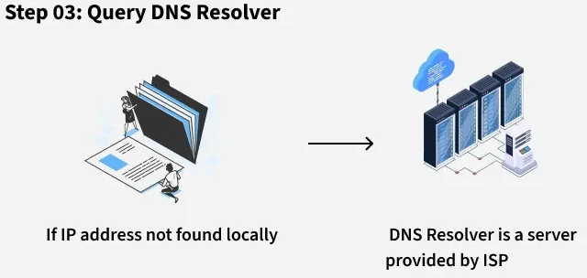
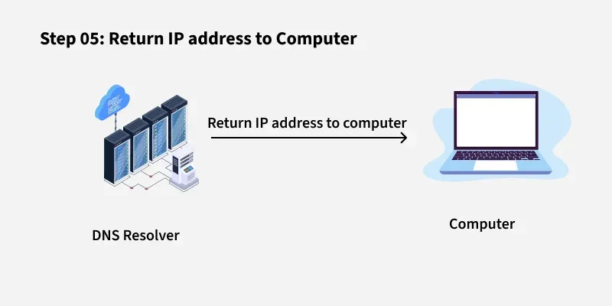
How Does DNS Work?

Slide 29
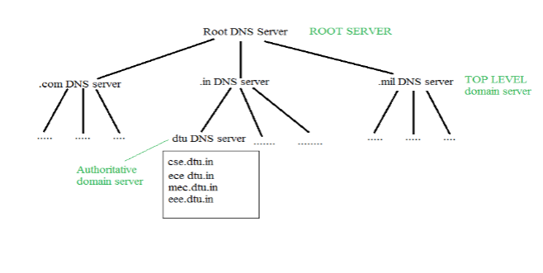
Structure of DNS
DNS operates through a hierarchical structure, ensuring scalability and reliability across the global internet infrastructure. Here's how it’s organized:
Root DNS Servers: These are the highest-level DNS servers and know where to find the TLD servers. They are crucial for directing DNS queries to the correct locations.
TLD Servers: These servers manage domain extensions like .com, .org, .net, .edu, .gov and others. They help route queries to the authoritative DNS servers for specific domains.
Authoritative DNS Servers: These are the servers that store the actual DNS records for domain names. They are responsible for providing the correct IP addresses that allow users to reach websites.

Slide 30
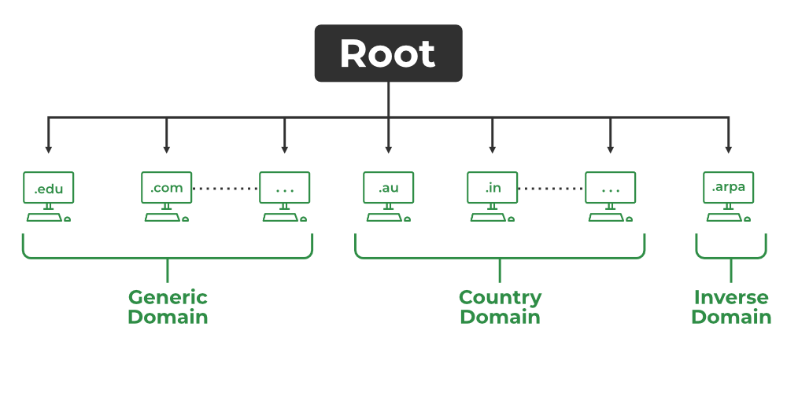
Types of Domains
DNS helps manage a wide variety of domain types to organize the vast number of websites on the internet. Here are the primary categories:
Generic Domains: These include top-level domains like .com, .org, .net and .edu. These are widely used and recognized across the world.
Country Code Domains: These domains represent specific countries or regions, such as .in for India, .us for the United States, .uk for the United Kingdom and .jp for Japan.
Inverse Domains: Used for reverse DNS lookups, these domains help map IP addresses back to domain names. Reverse DNS lookups are useful for diagnostics and security purposes, ensuring that the source of network traffic is legitimate. So DNS can provide both the mapping for example to find the IP addresses of geeksforgeeks.org then we have to type

Slide 31
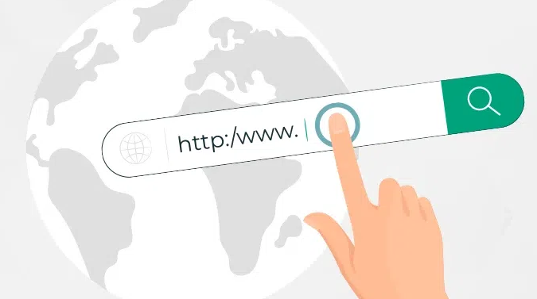
What is URL (Uniform Resource Locator) ?
A URL or Uniform Resource Locator is a Unique identifier that is contained by all the resources available on the internet. It can help to locate a particular resource due to its uniqueness. It is also known as the web address. A URL consists of different parts like protocol, domain name, etc. The users can access the URLs by simply typing them inside the address bar or by clicking any button or link web page.

Slide 32
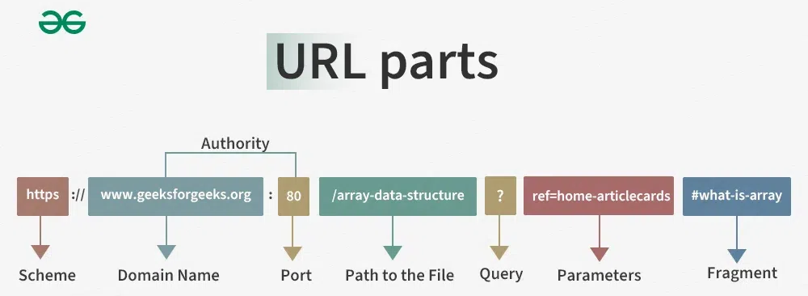
Different Parts of a URL
A URL consists of mutliple parts that can helps you to visit a particular page on the internet. Every part of a URL has its own importance. Let us discuss about the different parts of a URL.

Slide 33
URL parts
The protocol or scheme:
A URL starts with a protocol that is used to access the resource on the internet. The resource is accessed through the Domain Name System or DNS. There are multiple protocols avaiable to use like HTTP, HTTPS, FTP, mailto, TELNET etc. The protocol used in the above URL is https.
Domain or Host Name:
It is the reference or name of the page that you are going to access on the internet. In this case, the domain name is: www.geeksforgeeks.org.
Port Name:
It is defined just after the domain name by using the colons between itself and the domain name. Generally, it is not visible in the URL. The domain name and the port name combinely can be known as Authority. The default port for web services is port80 (:80).
Path:
It refers to the path or location of a particular file or page stored on the web server to access the content of it. The path used here is: array-data-structure.

Slide 34
URL parts
Query:
A query mainly found in the dynamic pages. It consists of a question mark(?) followed by the parameters. In above URL query is: ?.
Parameters:
These are the pieces of information inside a query string of URL. Multiple parameters can be passed to a URL by using the ampersand(&) symbol to separate them. The query parameter in above URL is: ref=home-articlecards.
Fragments:
The fragments appear at the end of a URL starts with a Hashtag(#) symbol. These are the internal page references that refers to a specific section within the page. The fragment in the above URL is: #what-is-array.

Slide 35
Basics of HTTP request/response cycle
Web applications run on a client-server model, meaning users access them through a web browser without needing to download or install anything. They rely on three key components:
Web Server – Handles user requests and directs them to the right place.
Application Server – Processes tasks and generates responses.
Database – Stores and retrieves data as needed.

Slide 36
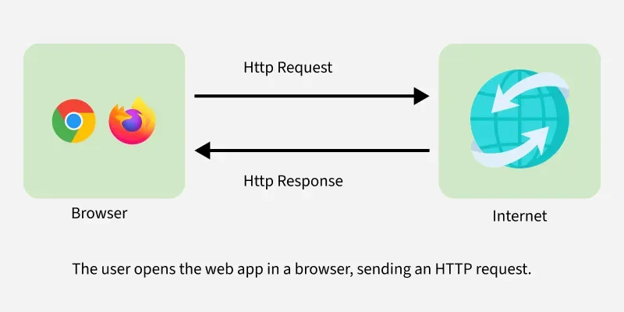
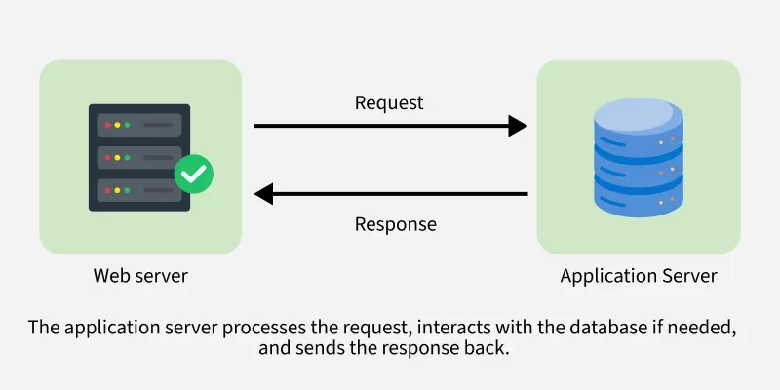
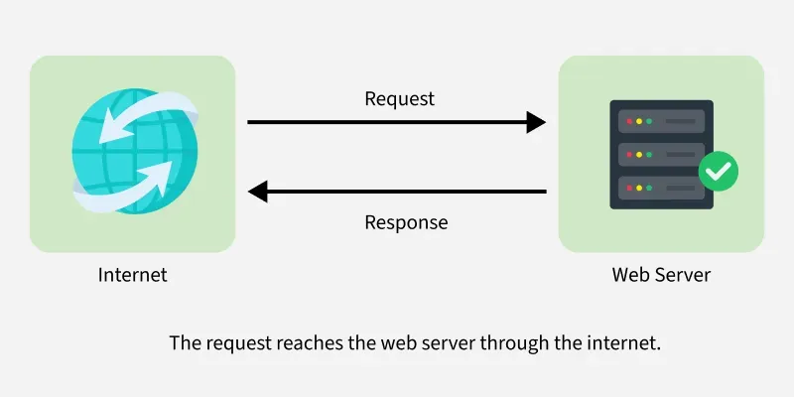
Basics of HTTP request/response cycle

Slide 37
Working:
User Request: A user accesses the web app, sending a request to the server.
Processing: The server processes the request, retrieves or updates data if needed.
Response: The processed data is sent back and displayed in the browser.

Slide 38
Technologies Behind Web Apps
Front-end (User Interface): Built using HTML, CSS, and JavaScript for interactive elements.
Back-end (Server Logic): Uses languages like Python, Java, Ruby, or PHP to handle logic and database interactions.
Data Storage: Information is stored in databases, often in cloud-based systems for easy access from any device.

Slide 39
Examples of Web Apps
Google Docs: Think of Google Docs as an online notepad that lets you write, edit, and collaborate in real time. Whether you’re working on a story or making a list, multiple people can edit the same document from anywhere.
Trello: Trello is like a digital task board that helps you stay organized. Whether you’re planning an event or managing a project, you can create, move, and track tasks using virtual cards. It’s a simple and effective way to manage work, assign tasks, and track progress making it perfect for teams.
Gmail: Gmail is your online mailbox, letting you send and receive emails from any device. No need for special software, just open your browser, log in, and you’re ready to go. You can even attach files, send images, and chat with friends effortlessly
Facebook: Facebook is like a virtual hangout where you can connect with friends, share posts, and chat. It’s a space to upload photos, like and comment on updates, and stay connected.

Slide 40
Key Characteristics of Web App
Accessibility: Consider having a powerful tool or game that you can access from anywhere. With a web app, you're not limited to a single device. Whether you're on a computer, tablet, or phone, you can use the app directly from your browser, no need for downloads or installations. Just open your browser and get started!
Platform Independence: One of the best things about web apps is that they work on any operating system. Whether you're using Windows, macOS, or Linux, a web app runs smoothly without compatibility issues.
Automatic Updates: All of us have experienced the manual effort of updating software. Web apps update automatically because they run on a remote server. That means every time you open the app, you’re using the latest version, without needing to install anything.
Collaboration: Many web apps allow real-time collaboration, making teamwork easier. Whether you're working on a document, project, or design, multiple people can edit and contribute at the same time, even from different locations.

Slide 41
Benefits
Cross-Platform Compatibility: Web apps run on computers, tablets, and phones without needing different versions. Just open a browser, and you're ready to use it.
Automatic Updates: No need to manually update apps. Since everything runs on a server, web apps always load the latest version automatically.
Cost-Efficiency: Developers create a single app that works across all devices, saving time and resources instead of building separate versions for different platforms.
Real-Time Collaboration: Web apps allow multiple users to work together at the same time, no matter where they are. Changes appear instantly, making teamwork smoother.
No Installation Needed: Unlike traditional apps, web apps don’t require downloads or installations. Just open the browser, enter the app’s URL, and start using it instantly.

